Slide 1
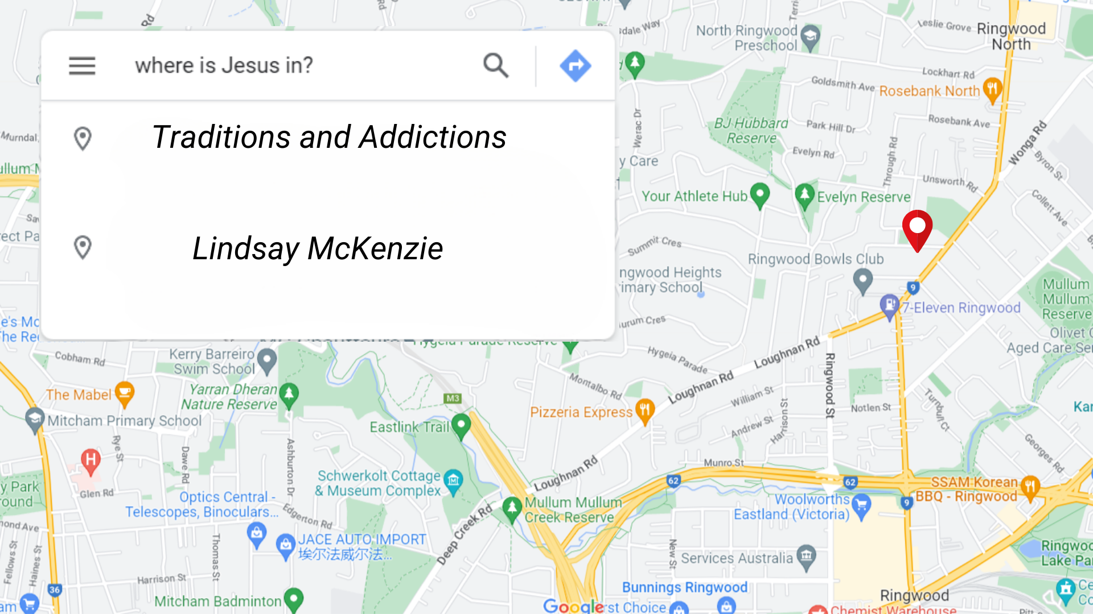

Slide 2
What are addictions?
“Addiction is a condition in which a person engages in use of a substance or in a behaviour for which the rewarding effects provide a compelling incentive to repeatedly pursue the behaviour despite detrimental consequences.” - Psychology Today
“People engage in potentially addictive activities to escape discomfort — both physical and emotional. People typically engage in psychoactive experiences to feel good and to feel better. The roots of addiction reside in activities associated with sensation seeking and self-medication. – Harvard University

Slide 3
Whatever a person is addicted to, they can't control how they use it, and they often become dependent on it to get through daily life.

Slide 4
Illicit drugs
Prescription drugs
Alcohol
Gambling (sports bets, etc.)
Video Game addictions
Co-dependent relationships
Sex addiction (pornography)

Slide 5
Back story of addictions -
A person just doesn’t get up one day and decide to take on an addiction. It is a subtle downward spiral but the burning question is: where does that downward spiral begin?

Slide 6
Myk – Enabling & Co-dependence

Slide 7
In John chapter 8 Jesus says makes two important declarations :
“You will know the truth and the truth will set you free.” John 8:32

Slide 8
Thomas Aquinas

Slide 9
Luke 4:18
“The Spirit of the Lord is on me, because he has anointed me to proclaim good news to the poor. He has sent me to proclaim freedom for the prisoners and recovery of sight for the blind, to set the oppressed free.”

Slide 10
In John chapter 8 Jesus says makes two important declarations :
“You will know the truth and the truth will set you free.” John 8:32
“If the Son sets you free, you will be completely free.” John 8:36

